Slide 1
DAYALEKTOR
Belchez, Maica L.
Carpio, Aira Joyce A.
Gardon, Jana Marie G.
Haboc, Florence Gail G.

Slide 2
Event Table

Slide 3
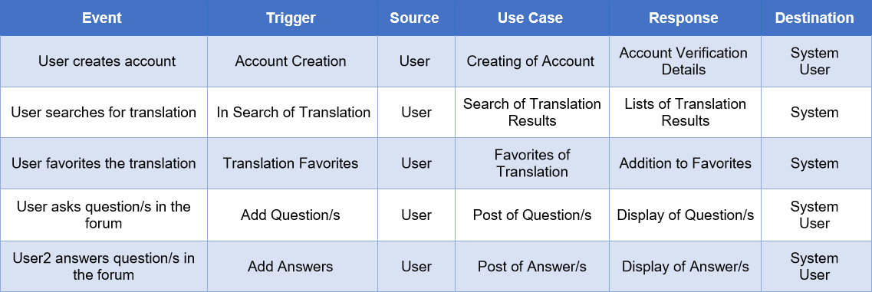

Slide 4
Use Case Full Description

Slide 5
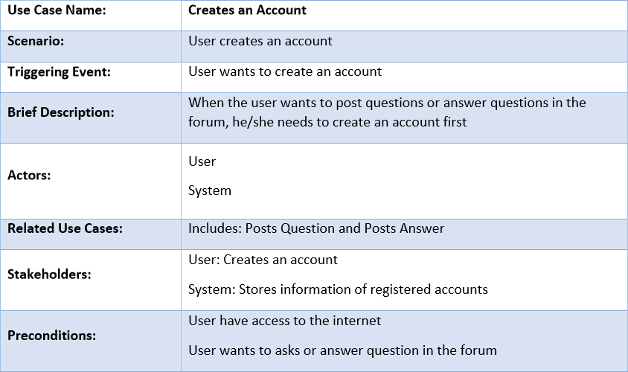

Slide 6
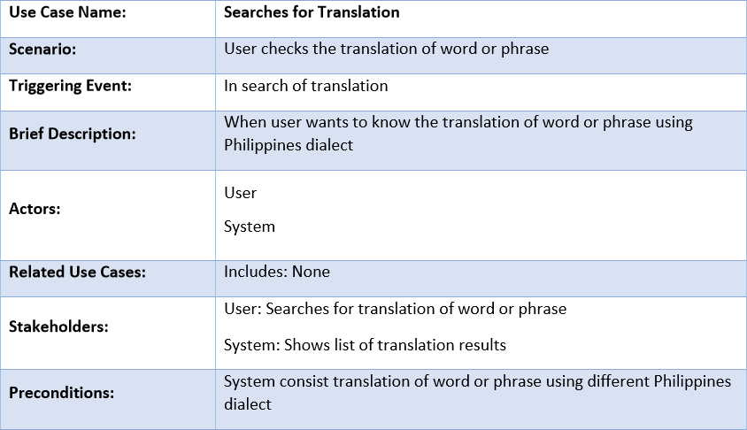

Slide 7
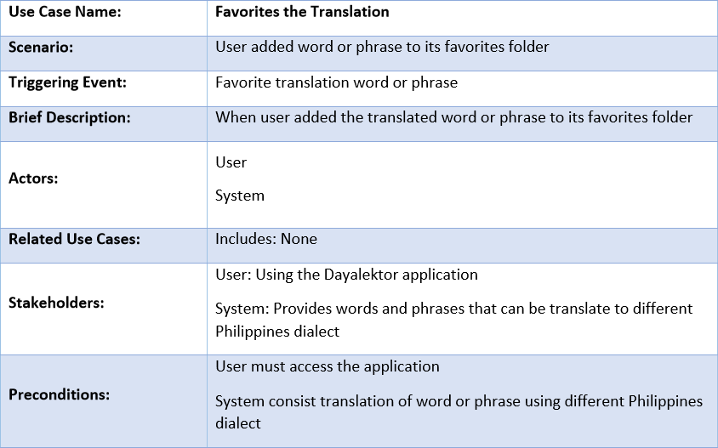

Slide 8
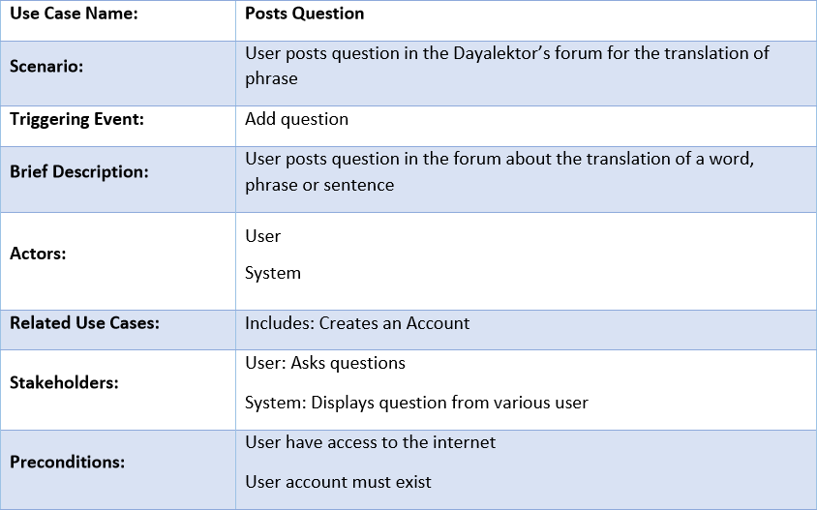

Slide 9
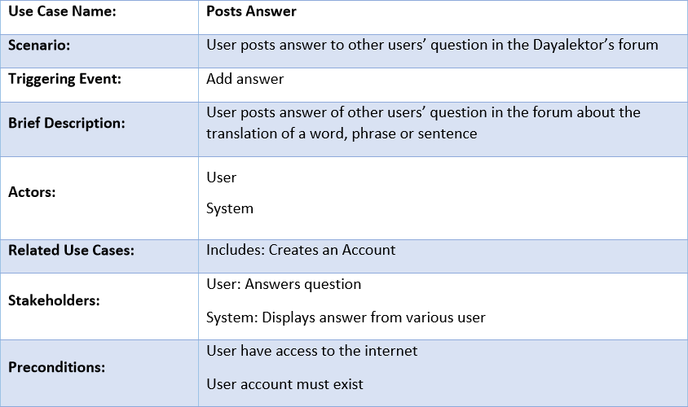

Slide 10
Entity Relationship Diagram

Slide 11
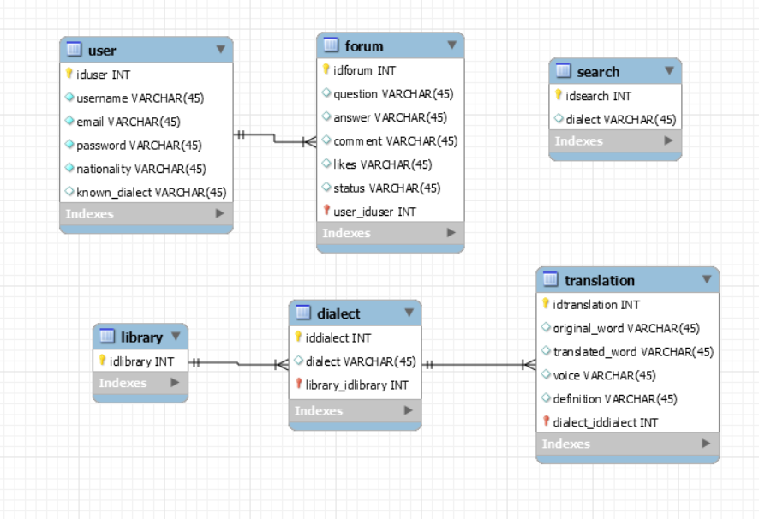

Slide 12
Prototype

Slide 13
Pitch Video

